Slide 1
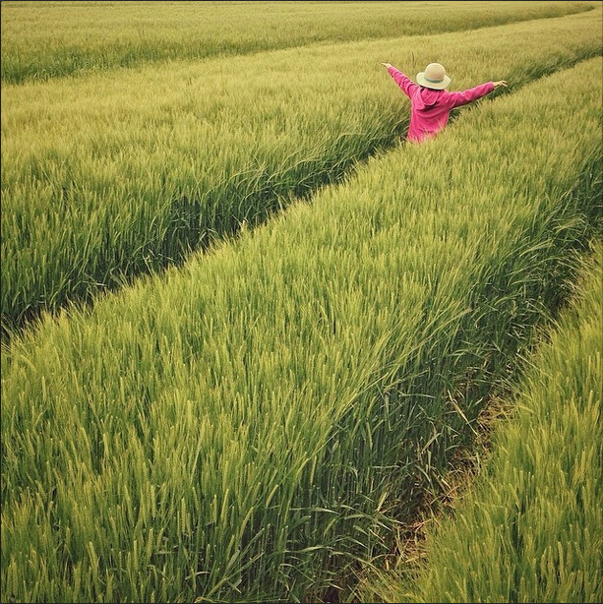
Wild Plants Edibility Prediction
Using IBM Watson
Investing in a greener tomorrow

Slide 2
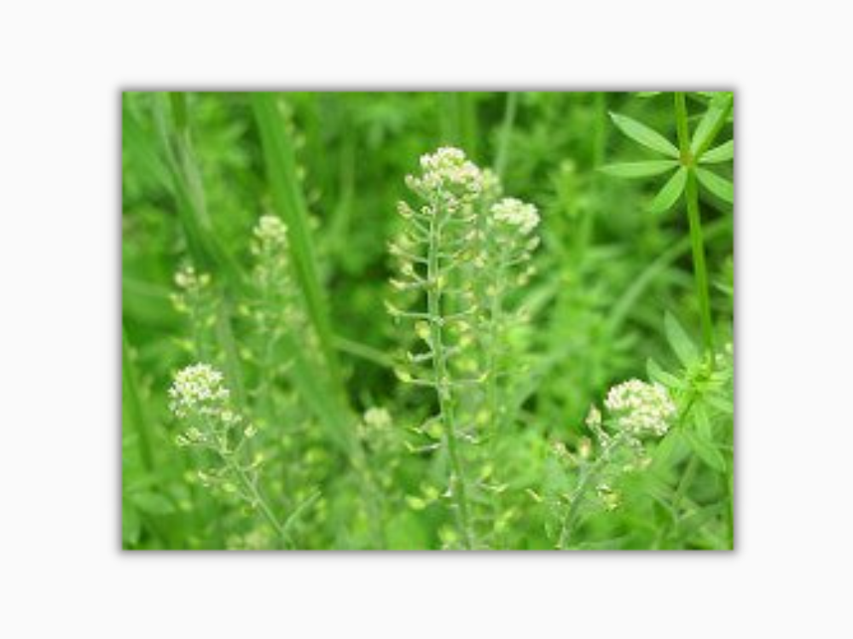
Group Members
Asmi Panigrahi (19BAI10185)
Sirshak Sarkar (19BCY10127)
Sapratibh Dev (19BCY10112)
Viplav Khubchandani (19BAI10106)

Slide 3
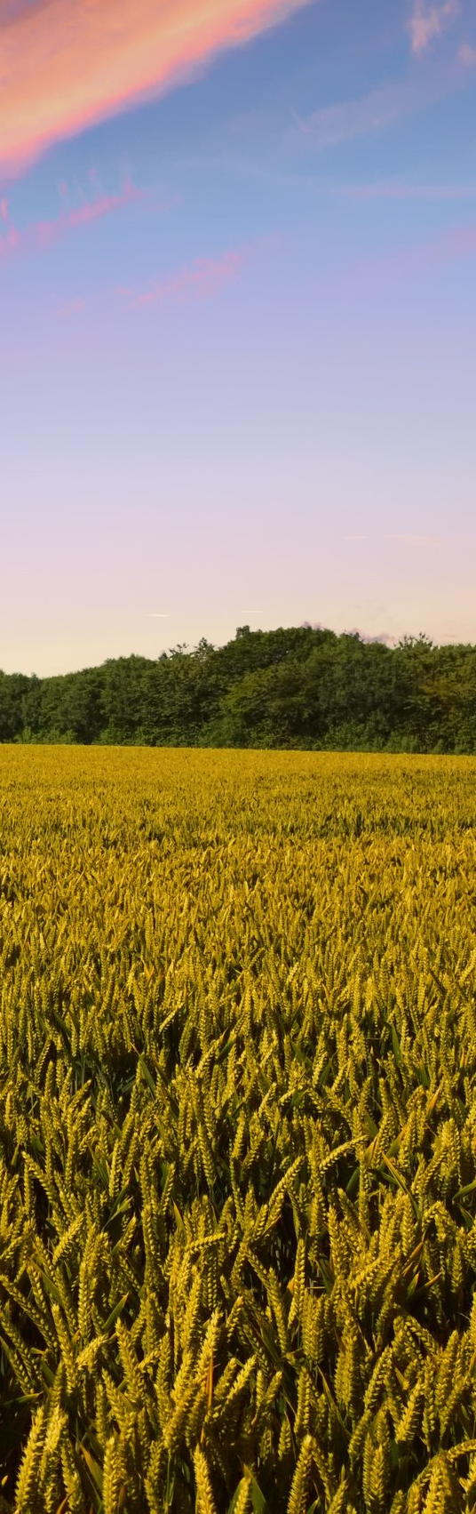
Motivation for building the model
The rural communities of developing countries depend on wild edible plants to meet their food requirements during periods of food shortage.
Wild edible plants are mostly serving as supplementary foods in different parts of the world because they are nutritionally rich and can supplement especially vitamins and micro nutrients.
The main objective of this project is to build Convolutional neural networks are a deep model to detect and classify the edibility of the wild plant. The model also suggests the effects of non-edible wild plant produce.

Slide 4
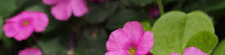
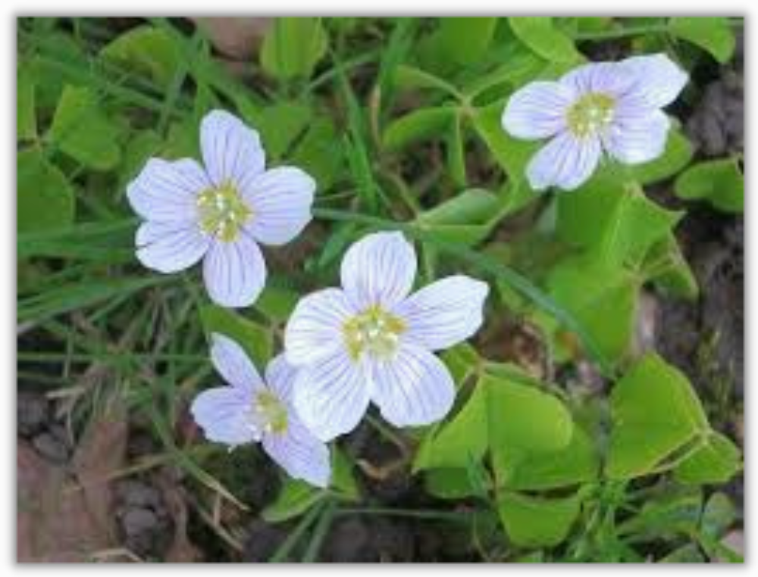
The proposed solution
We created a Flask application where the user selects the image which is to be classified.
The image is fed into the model that is trained and the predicted class will be displayed on the webpage using Convolution Neural Networks (CNN).

Slide 5
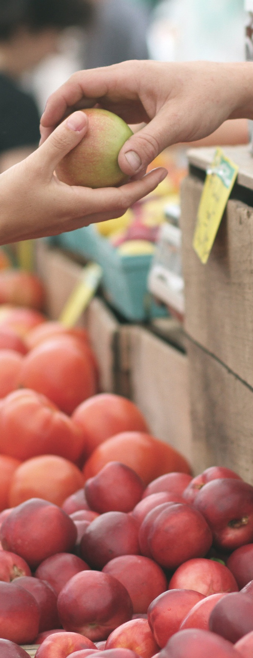
Software used to make the model
*Jupyter Notebook
*Microsoft Visual Studio Code - Python Error Auditing only
* Numpy
* Tensorflow
* Keras
* HTML CSS
* Javascript
* Python Libraries
* FLask

Slide 6
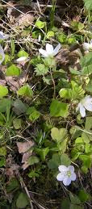
Methodology
Stage 1
User interacts with User interface to upload image
Stage 2
Uploaded image is analyzed by the model which is integrated
Stage 3
Once model analyses the uploaded image, the prediction is showcased on the UI

Slide 7
Work done to make the model
Data Collection:
We collected the given dataset from Project Workspace.
Data Preprocessing:
It was done by using the ImageDataGenerator library.
Model Building:
We built the model using required libraries and worked on the accuracy to give correct predictions.
Application Building:
We built the application using HTML, CSS and Javascript. Flask was used as the server to launch the application.

Slide 8
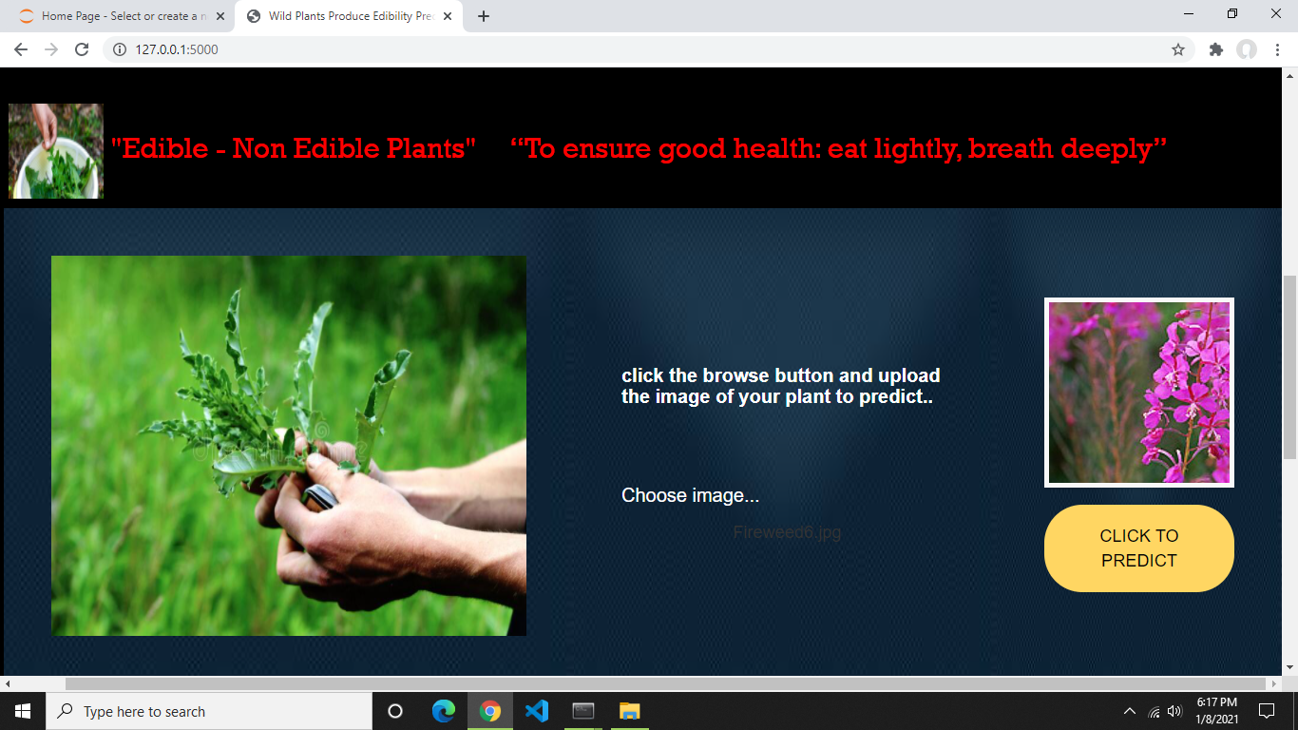
Output and Web representation

Slide 9
Conclusion
The project works sufficiently well in predicting the edibility of an image of a wild plant uploaded to it. The use of Convolutional neural networks greatly helps the use case as predicted. The website created is intuitive to use, simple to understand and fast in its response. It provides ample knowledge of the plant picture uploaded to it.
The prediction and classification of wilds plants and their edibility is a powerful source to have for many use cases, for example, for adventurists to travel to remote areas with limited sources of food, for people living in villages where a staple source of food is wild plants.

